Slide 1
SQL Server 2000 Internals
Indexes – Part II
Ramkumar Murugesan

Slide 2
Indexes – Part II
Estimating Index space
Calculating Actual Index Size
Fragmentation
Special Indexes
Index – Best Practices

Slide 3
Next Section>>>
Estimating Index Space
Topics…
Index Size | Estimating CI Space | Estimating NCI Space | Summary

Slide 4
Estimating Index Space
Size of an index is based on the size of the index keys and the number of rows in the table
Size of Index Keys determine how many index rows can fit on an index page
Index size refers to the size of the index tree
One index row can point to a full page of table data.
So, Number of index pages at intermediate level is the bytes available per page divided by the index key row size, and this quotient divided into the number of data pages
Repeat this until a level with only one page is reached.
That page is the root

Slide 5
Space Estimation - Clustered Index
Consider a table of 10,000 pages and 500,000 rows with a clustered key of a 5-byte fixed-length character
The index key row size is 12 bytes (as per index row format), so we can fit 674 (8096 bytes available on a page / 12 bytes per row) rows on an index page
Since we need index rows to point to all 10,000 pages, we'll need 15 index pages (10000 / 674) at leaf level
Now, all these index pages need pointers at next higher level
Since one page can contain 15 index rows to point to these 15 pages, the next higher level will be the root
Totally, 128 bytes are required for storing index pages

Slide 6
Space Estimation - Non-Clustered Index
Assuming, 10,000-page table also has a 5-byte fixed-length character nonclustered index
The leaf-level rows (level 0) will be 11 bytes long as they will each contain a clustered index key (5 bytes), a nonclustered index key (5 bytes) and 1 byte for the status bits
An index page can hold 736 index rows at this leaf level
Since there are 500,000 index rows, we need 680 leaf pages
If the NCI is unique, the index rows at the higher levels will be 12 bytes each, so 674 index rows will fit per page, and we'll need two pages at level 1, with level 2 as the one root page

Slide 7
Space Estimation - Summary
For the clustered index, we had 16 index pages for a 10,000-page table, which is less than 1 percent of the size of the table
So, 1 percent would be a ballpark estimate for the space requirement of a clustered index, even though you can see that in this case it's an overly large estimate
On the other hand, our nonclustered index needed 683 pages for the 10,000-page table, which is about 6 percent additional space
Practically for non-clustered indexes, the space required would be 30-40% of the table size considering the size of the index keys

Slide 8
Next Section>>>
Calculating Actual Index Space
Topics…
sysindexes Table | sp_spaceused

Slide 9
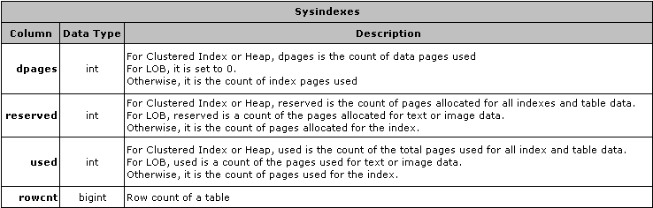
Calculating Actual Index Size
The actual space can be calculated from the sysindexes table
The stored procedure sp_spaceused examines these values and reports the total size used by a table

Slide 10
Calculating Actual Index Size
sysindexes table will not be updated
  Every time a table/index is modified
  When a Bulk insert happens
  When a table is created
You can force SQL Server to update sysindexes in two ways
  sp_spaceused ‘table_name’, True
  dbcc updateusage (table_name or 0)
After the first 8 pages are allocated to a table, SQL Server grants all future allocations in units of 8 pages, called extents
The sum of all the allocations is the value of reserved
The sum of all used pages are counted as used

Slide 11
Next Section>>>
Fragmentation
Topics…
Internal/External Fragmentation | Detecting Fragmentation | Removing Fragmentation

Slide 12
Internal Fragmentation
Internal fragmentation occurs when space is available within your index pages - that is, when the indexes are not making the most efficient use of space
Internal fragmentation means that the index is taking up more space than it needs to
It is useful in cases where there are more inserts than selects in a table
Having room on a page means that there is space to insert more rows without having to split a page
Splitting is a relatively expensive operation and should be minimized as and when possible

Slide 13
External Fragmentation
External fragmentation occurs when the logical order of pages does not match the physical order, or when the extents belonging to a table are not contiguous
External fragmentation is bad only when SQL Server is doing an ordered scan of all or part of a table/ index
If seeking for individual rows through an index, it doesn't matter where those rows are physically located—SQL Server can find them easily
If SQL Server is doing an unordered scan, it can use the IAM pages to determine which extents need to be fetched

Slide 14
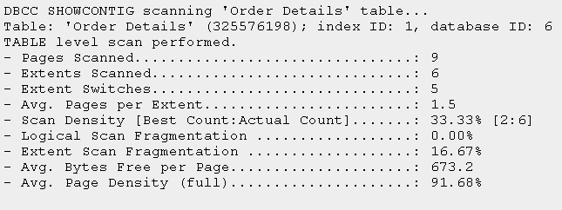
Detecting Fragmentation
DBCC SHOWCONTIG command reports fragmentation of an index
  Syntax: DBCC SHOWCONTIG (‘table_name’, ‘index_name’)
The output of SHOWCONTIG is shown below…

Slide 15
Detecting Fragmentation
DBCC SHOWCONTIG scans the page chain at the leaf level of the specified index and keeps track of the following values
  Average number of bytes free on each page
  Number of pages accessed (Pages scanned)
  Number of extents accessed (Extents scanned)
  Number of times a page had a lower page number than the previous page in the scan
  This value for Out of order pages is not displayed, but it is used for additional computations
  Number of times a page in the scan was on a different extent than the previous page in the scan (Extent Switches)

Slide 16
Detecting Fragmentation
An extent is identified by the page number of its first page
So, if extents 8, 16, 24, 32, and 40 make up an index, there are no gaps
If the extents are 8, 16, 24, and 40, there is one gap
Extent Scan Fragmentation is computed by dividing the number of gaps by the number of extents
For example, A table using extents 8, 24, 40, and 56 has 3 gaps, and its Extent Scan Fragmentation is ¾, or 75 percent
The maximum number of gaps is the number of extents - 1, so Extent Scan Fragmentation can never be 100 percent

Slide 17
Detecting Fragmentation
Logical Scan Fragmentation is computed by dividing the number of Out Of Order Pages by the number of pages in the table. This value is meaningless in a heap
Either Extent Scan Fragmentation or Logical Scan Fragmentation indicate the general level of fragmentation for a table
Lower the value, the less fragmentation there is
Scan Density too tells the amount of fragmentation
It is computed by dividing the optimum number of extent switches by the actual number of extent switches
A high value means that there is little fragmentation
Scan Density is not valid if the table spans multiple files

Slide 18
Removing Fragmentation
Rebuilding indexes (DBCC DBREINDEX) will have SQL Server allocate all new contiguous pages
Disadvantage: Table will be unavailable while CI is rebuilt.
If it is NCI, table can be viewed, but no modification can be done
Alternatively DBCC INDEXDEFRAG can be used
De-fragmenting indexes reorders the leaf level pages into physical order as well as logical order, but using only the pages that are already allocated to the leaf level
Both rebuilding and defragmenting restores pages to the original fill factor that is defined in sysindexes table

Slide 19
Special Indexes
Index on views
  Indexes on views are physically stored where as Indexes on computed columns are not physically stored
  If an index is to be created on a view, the view definition should not contain…
    TOP, DISTINCT, SUM on a nullable expression,
    text, ntext, or image columns, a derived table,
    MIN, MAX, COUNT(*), COUNT(<expression>), STDEV, VARIANCE, AVG, The ROWSET function
    Another view
    UNION, Sub-queries, OUTER joins, or self-joins
    Full-text predicates (CONTAINS, FREETEXT)
    COMPUTE, COMPUTE BY, ORDER BY

Slide 20
Next Section>>>
Index Best Practices
Topics…
Identifying columns for Clustered Index and Non-Clustered Index | Ideal condition for Clustered Index

Slide 21
Index Best Practices
Consider using a clustered index for a column that used in…
  Queries that return a range of values
  Queries that return large set
  In general, if your table is big, go for a clustered index
Consider using a non-clustered index for…
  High selectivity columns
  Columns that are specified in WHERE and ORDER BY clause
  Columns used in JOIN conditions
  When the columns to be indexed are very wide

Slide 22
Index Best Practices
An ideal condition for a clustered index is when the column is
  Unique
  Narrow
  Static
  Ever-increasing pattern

Slide 23
End of Topic – Indexes Part II
?

Slide 24
End of Topic – Indexes Part II
Thank you
Next Topic
Architecture Components | Storage Concepts | Transaction Logs | Indexes I | Indexes II | Locking I | Locking II | Query Processor

